Slide 1
Public Hearing on Redistricting
Houston Community College System
February 15, 2023

Slide 2

Today’s Objectives
Legal Overview/Criteria
Proposed Map 1A
Public Hearing
Next Steps

Slide 3
Legal Overview/Criteria

Slide 4

Legal Overview
WHAT?
        Redistricting is the process by which the boundaries of elective districts (e.g., single-member districts) are periodically redrawn in response to changes in population. The Houston Community College System is currently divided into nine single-member districts.

Slide 5
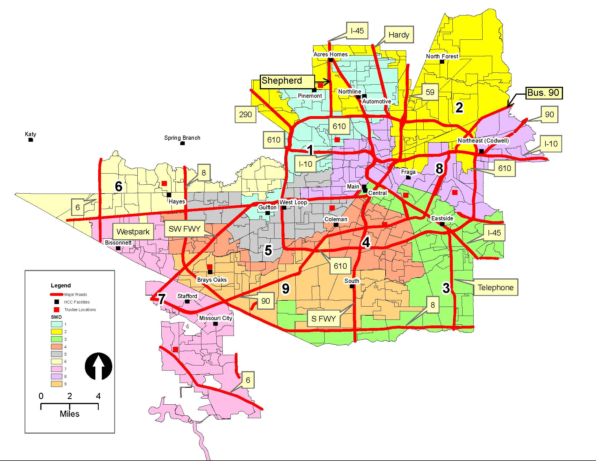
Current Board of Trustees Single Member Districts (2020 Census Blocks)

Slide 6

Legal Overview
WHY?
        Every ten years, the U.S. Census data is published including the most recent population statistics. Texas Education Code Section 130.0822 (a) and (k) requires a school board to re-divide single-member districts “if the census data indicates that the population of the most populous district exceeds the population of the least populous district by more than 10 percent.”

Slide 7
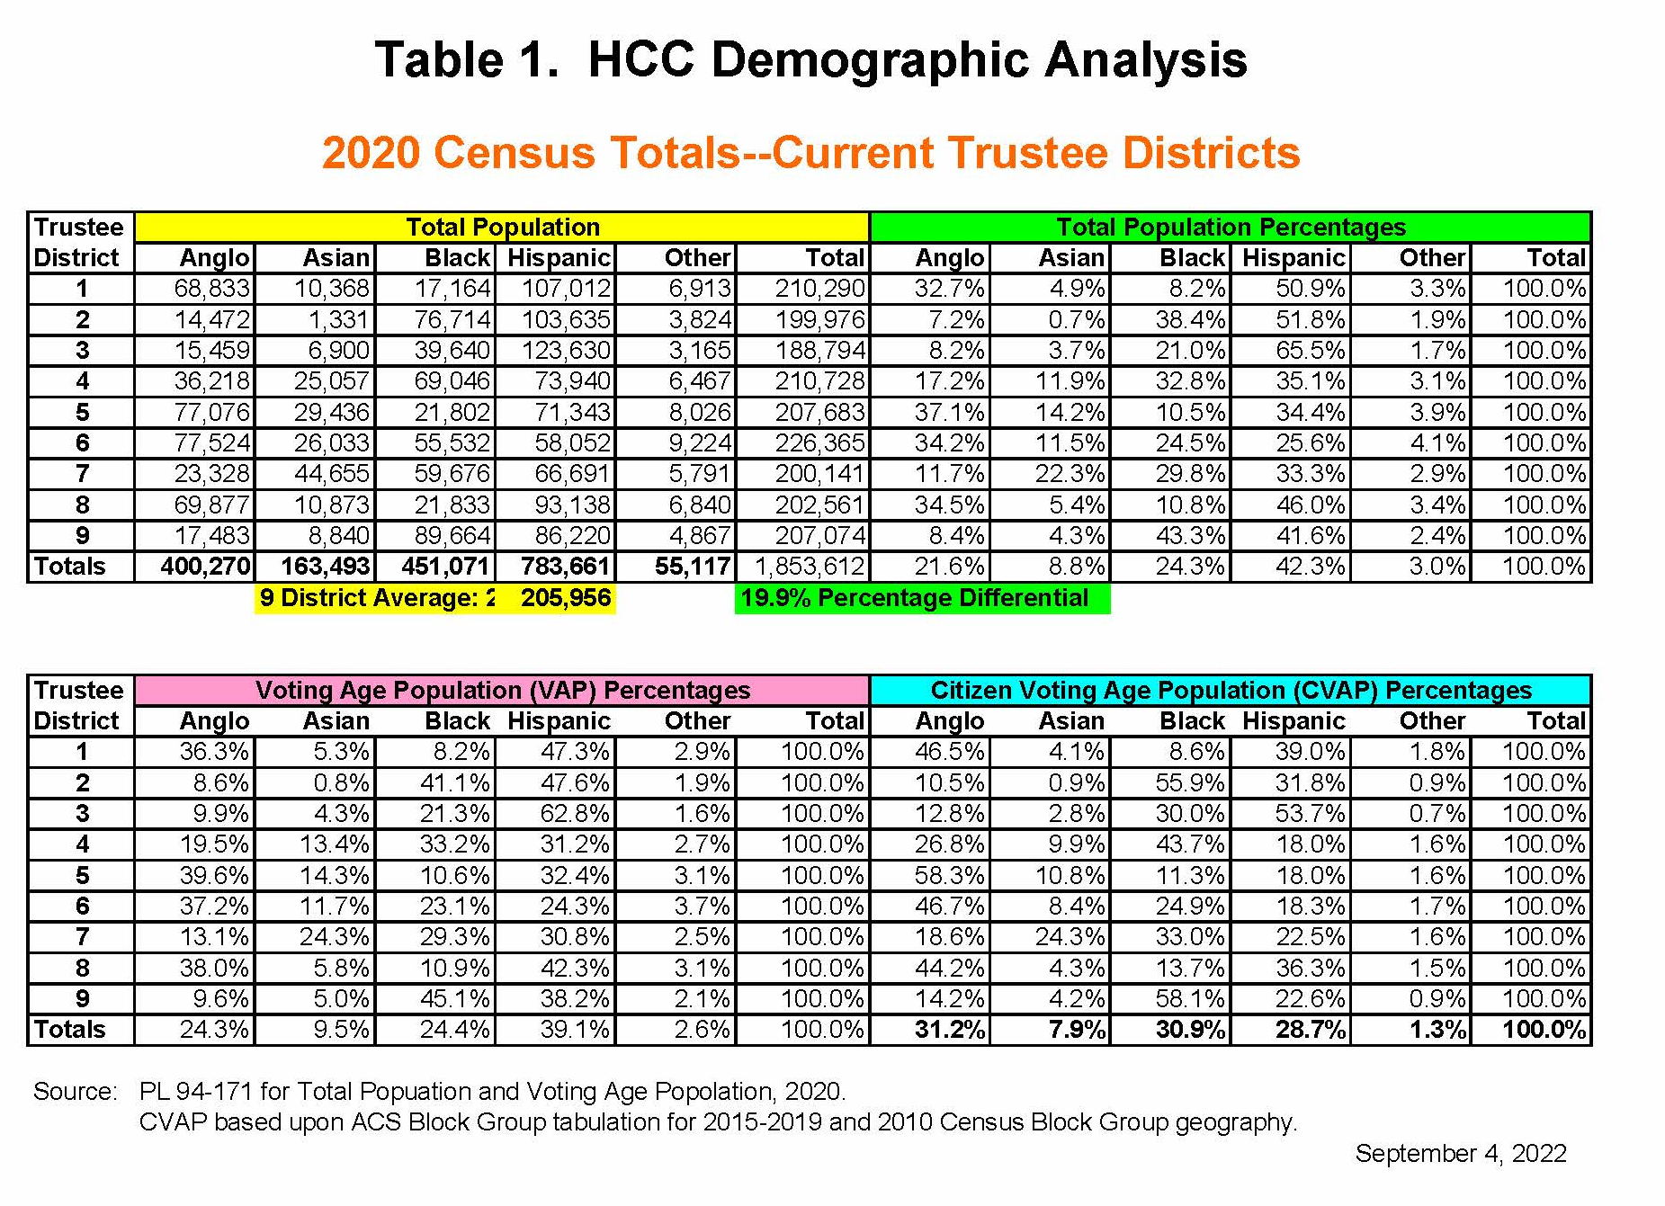

Slide 8

Legal Overview
WHEN?
        Not later than the 90th day before the day of the first regular trustee election at which trustees may officially recognize and act on the last preceding federal census, the board must redivide the district into the appropriate number of trustee districts if the census data indicates that the population of the most populous district exceeds the population of the least populous district by more than 10 percent.
        Houston Community College System holds elections in November of odd-numbered years. For the November 7, 2023 election date, the Board of Trustees is required to redistrict by August 9, 2023.

Slide 9
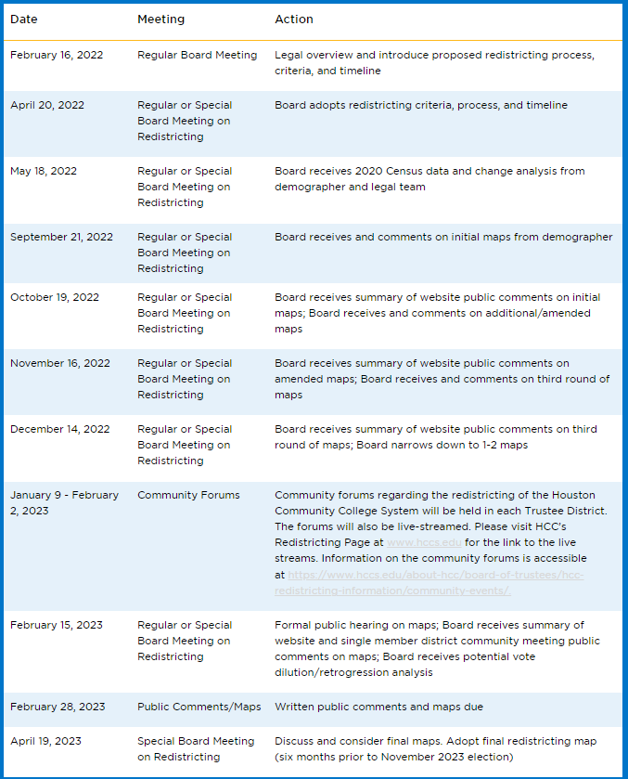
Board Adopted Timeline

Slide 10
Traditional Redistricting Criteria
Total deviation between largest and smallest district at or within 10%
Near-equal population
Avoid dilution/retrogression of minority voting rights
Compact and contiguous
Easily identifiable boundaries when possible
Preserve incumbent-constituency relations
Maintain communities of interest and keep neighborhoods together
Preserve existing SMD boundaries when possible
Avoid splitting county election precincts to the extent possible*

Slide 11
Plan 1A and Demographics

Slide 12
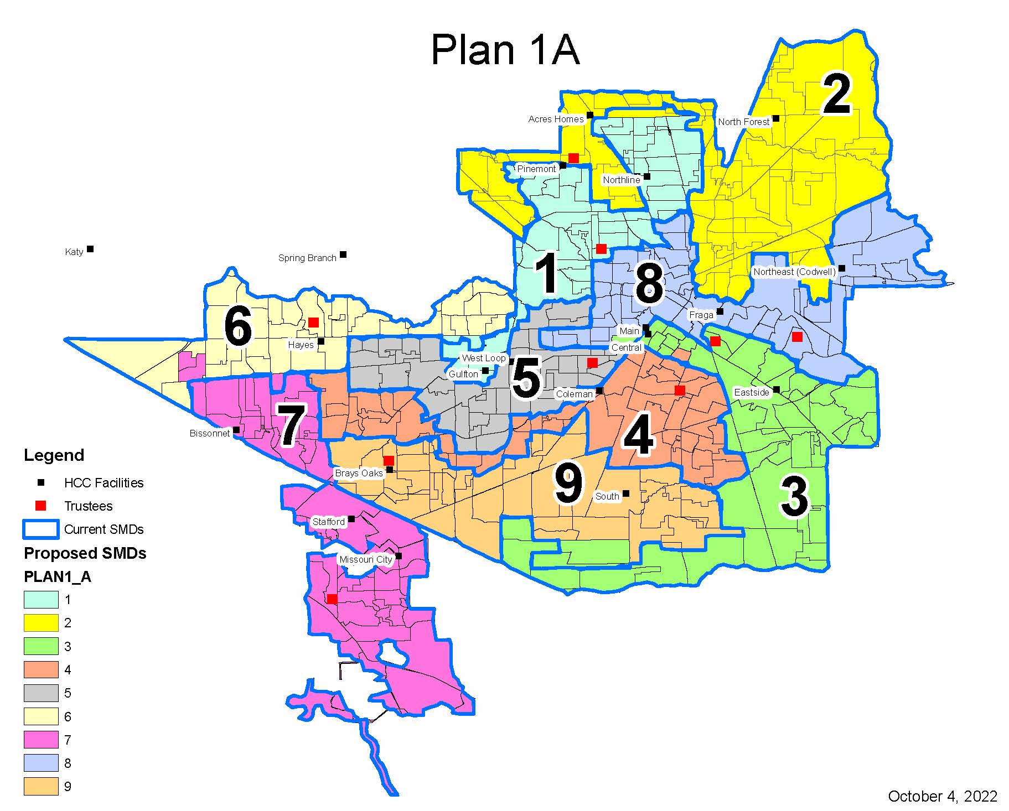






Slide 13
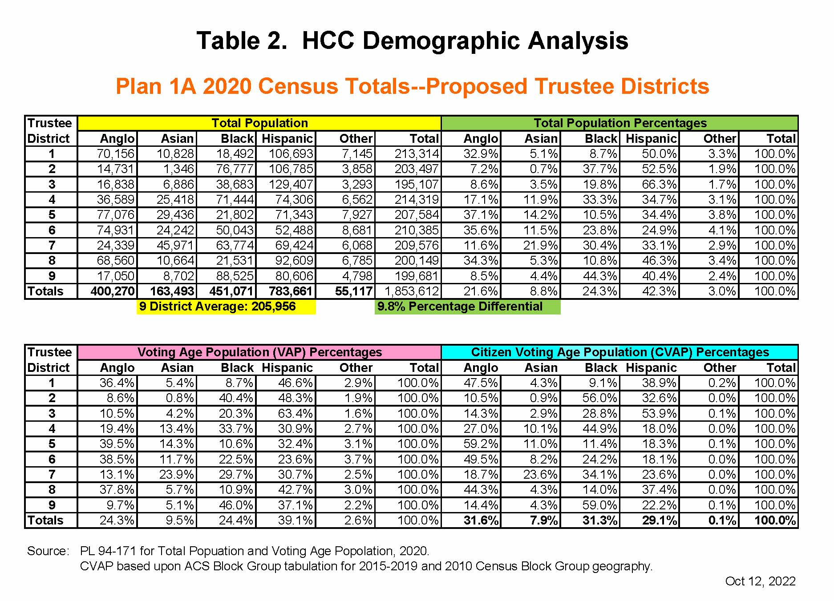

Slide 14
Plan 1A - Summary of Changes
SMD 1 gains population from SMD 6 in the SW
    Precinct 272
SMD 1 loses population to SMD 2 in the North
    Precincts 321, 571, 779
SMD 2 gains population from SMD 1 in Central South
    Precincts 321, 571, 779
SMD 3 loses population to SMD 4 in the NW
    Precinct 247
SMD 3 gains population from SMD 9 in the SW
    Precincts 131, 867
SMD 3 gains population from SMD 8 in the NW
    Precinct 123
SMD 4 gains population from SMD 3 in the North
    Precinct 247
SMD 5 gains population from SMD 8 in the NW
    Precincts 177, 895
SMD 6 loses population to SMD 7 in the West and Central South
    Precincts 814, 1126, 487
SMD 6 loses population to SMD 1 in the East
    Precinct 272
SMD 7 gains population from SMD 6 in the North
    Precincts 814, 1126, 487
SMD 8 loses population to SMD 5 in the W and S
    Precincts 177, 895
SMD 8 loses population to SMD 3 in SW
    Precinct 123
SMD 9 loses population to SMD 3 in the SE
    Precincts 131, 867

Slide 15
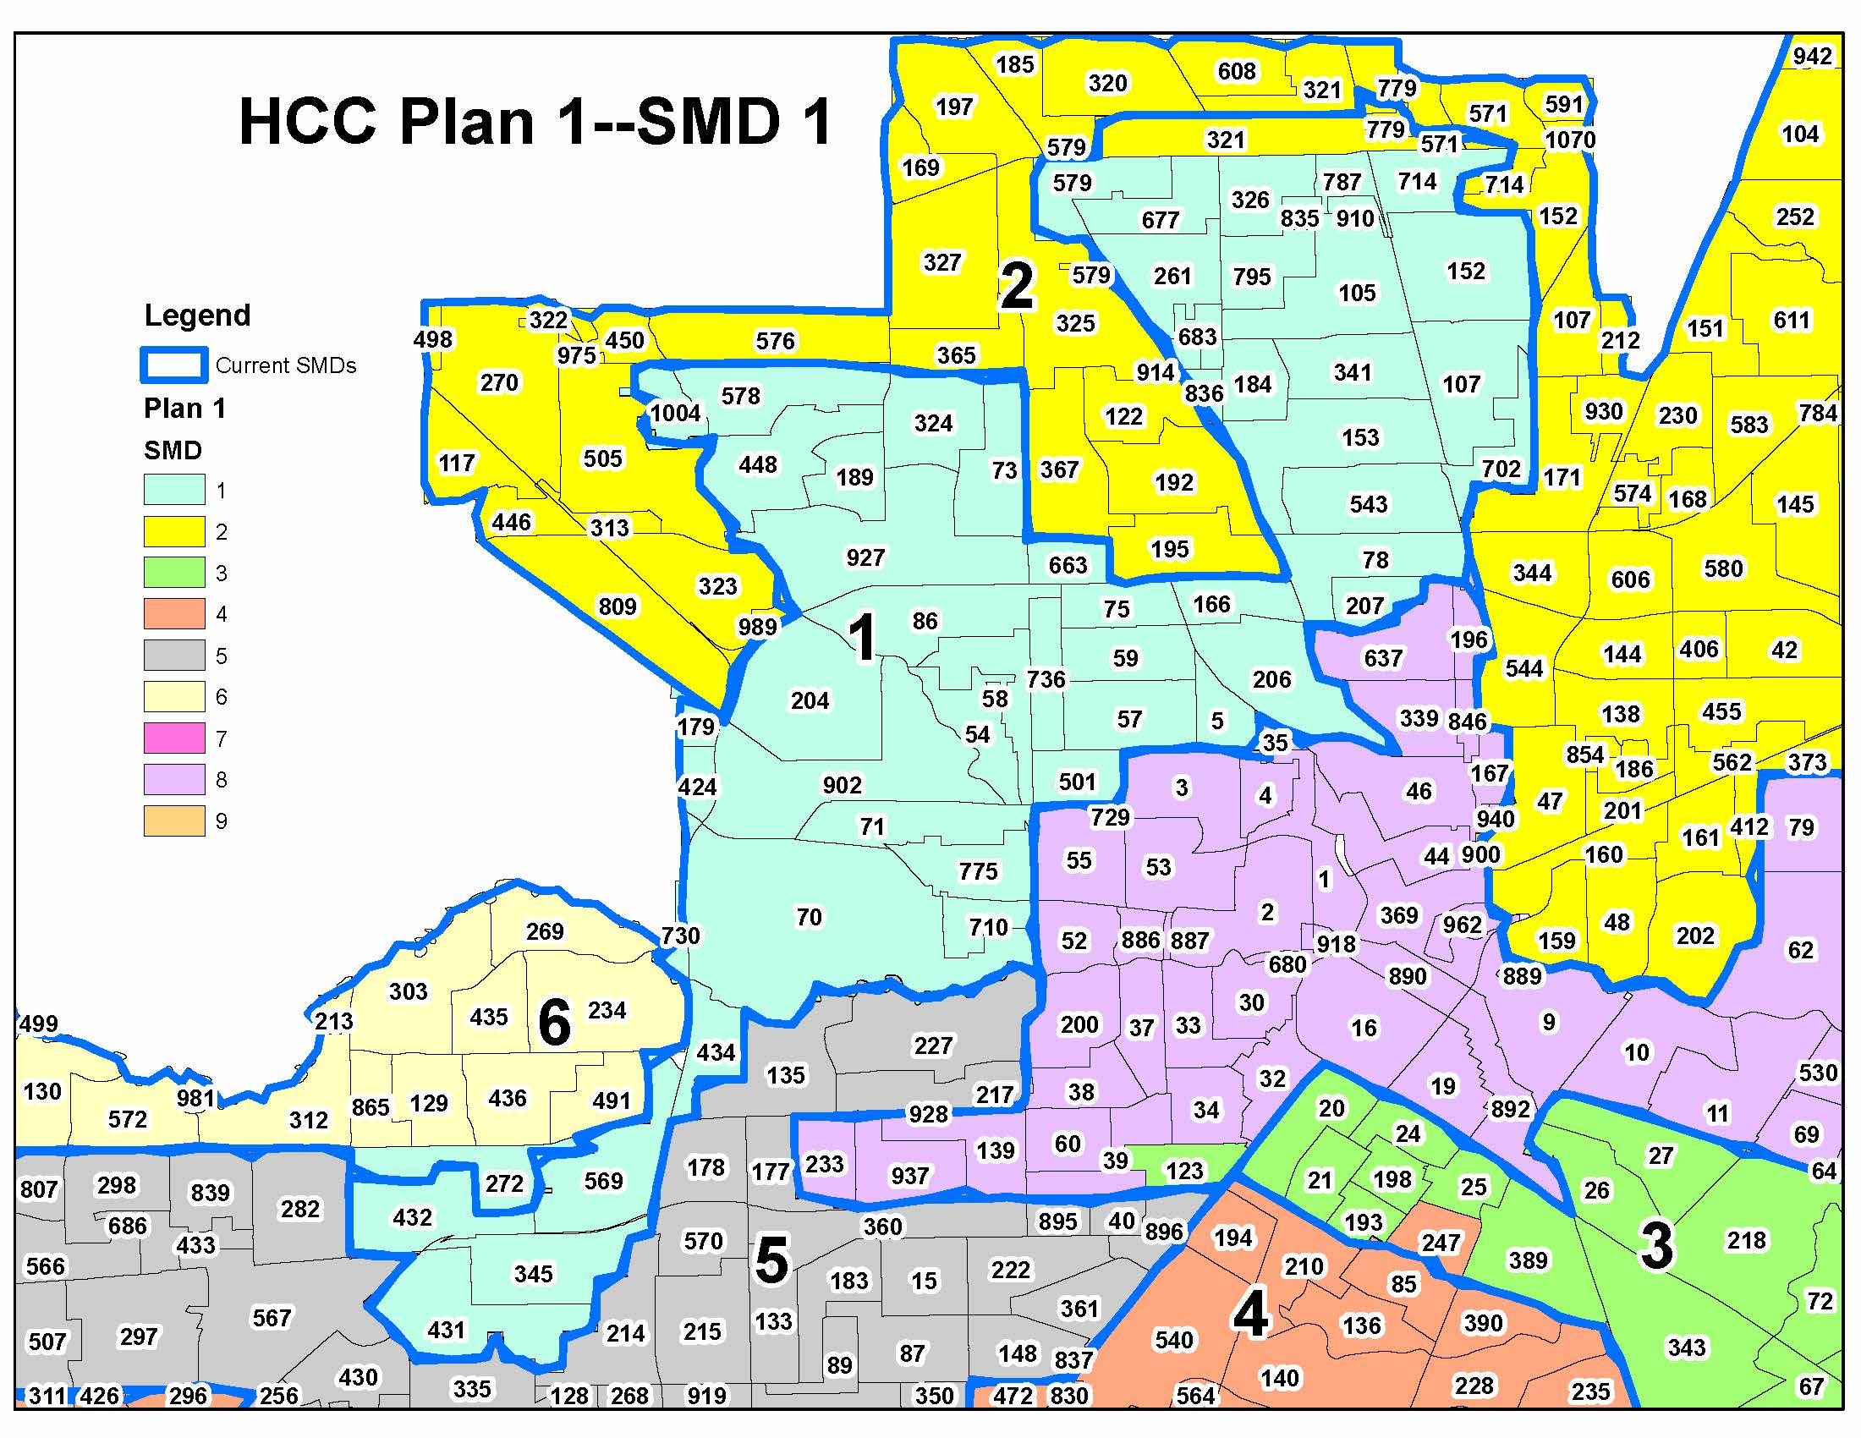
PLAN 1A – SMDs 1 and 2 CHANGES

Slide 16
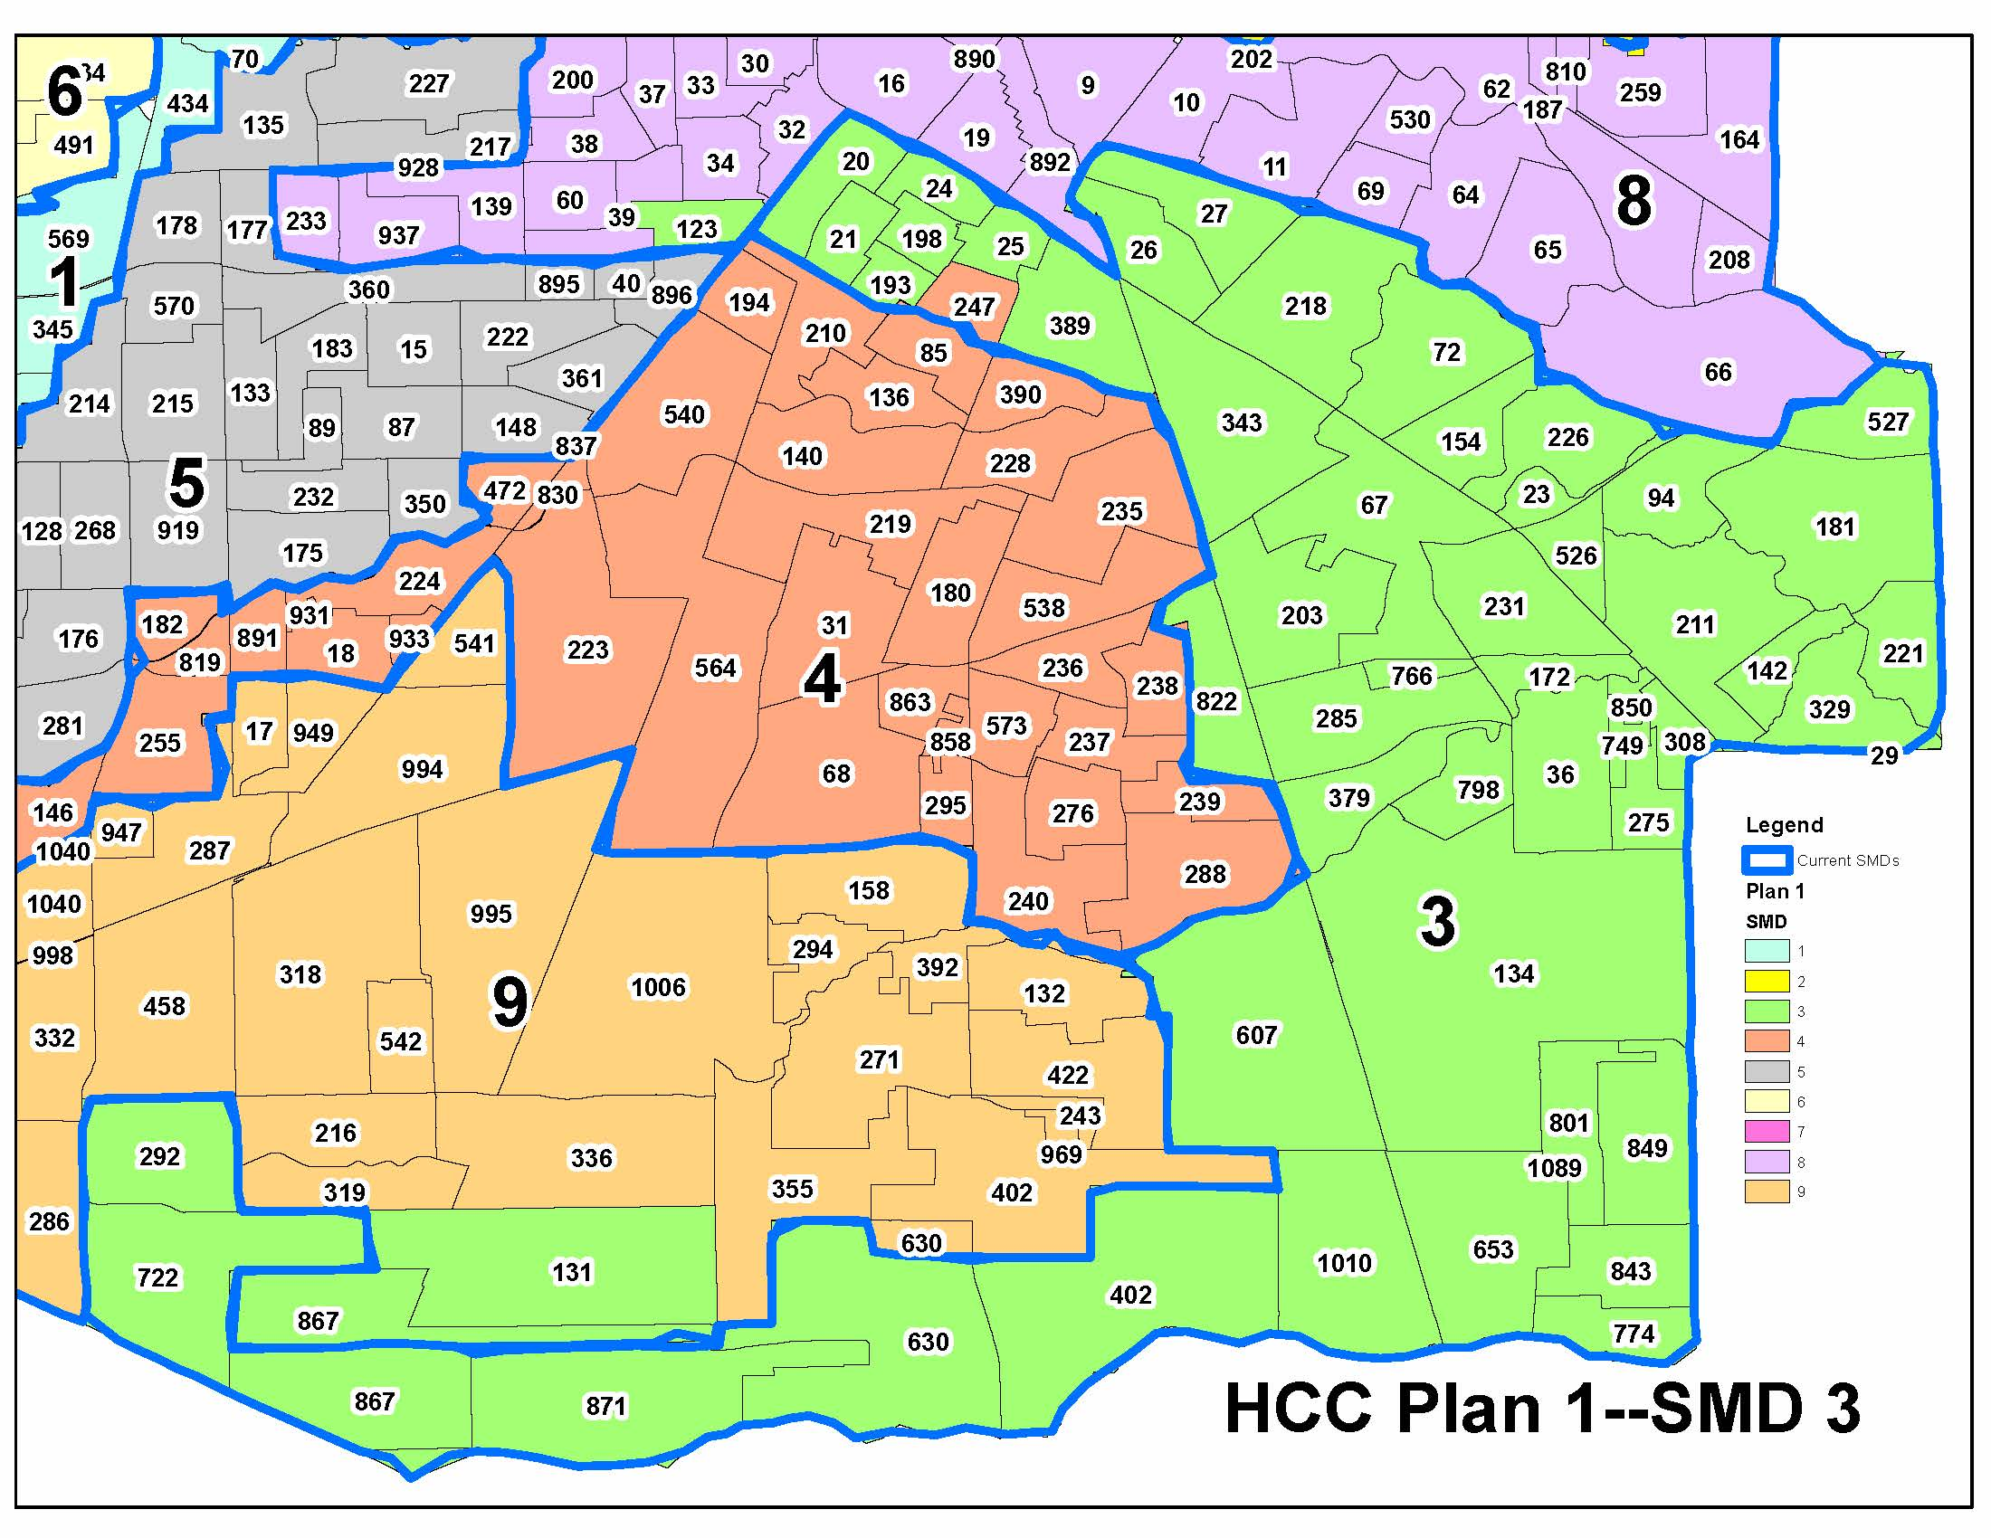
PLAN 1 A – SMDs 3 and 4 CHANGES

Slide 17
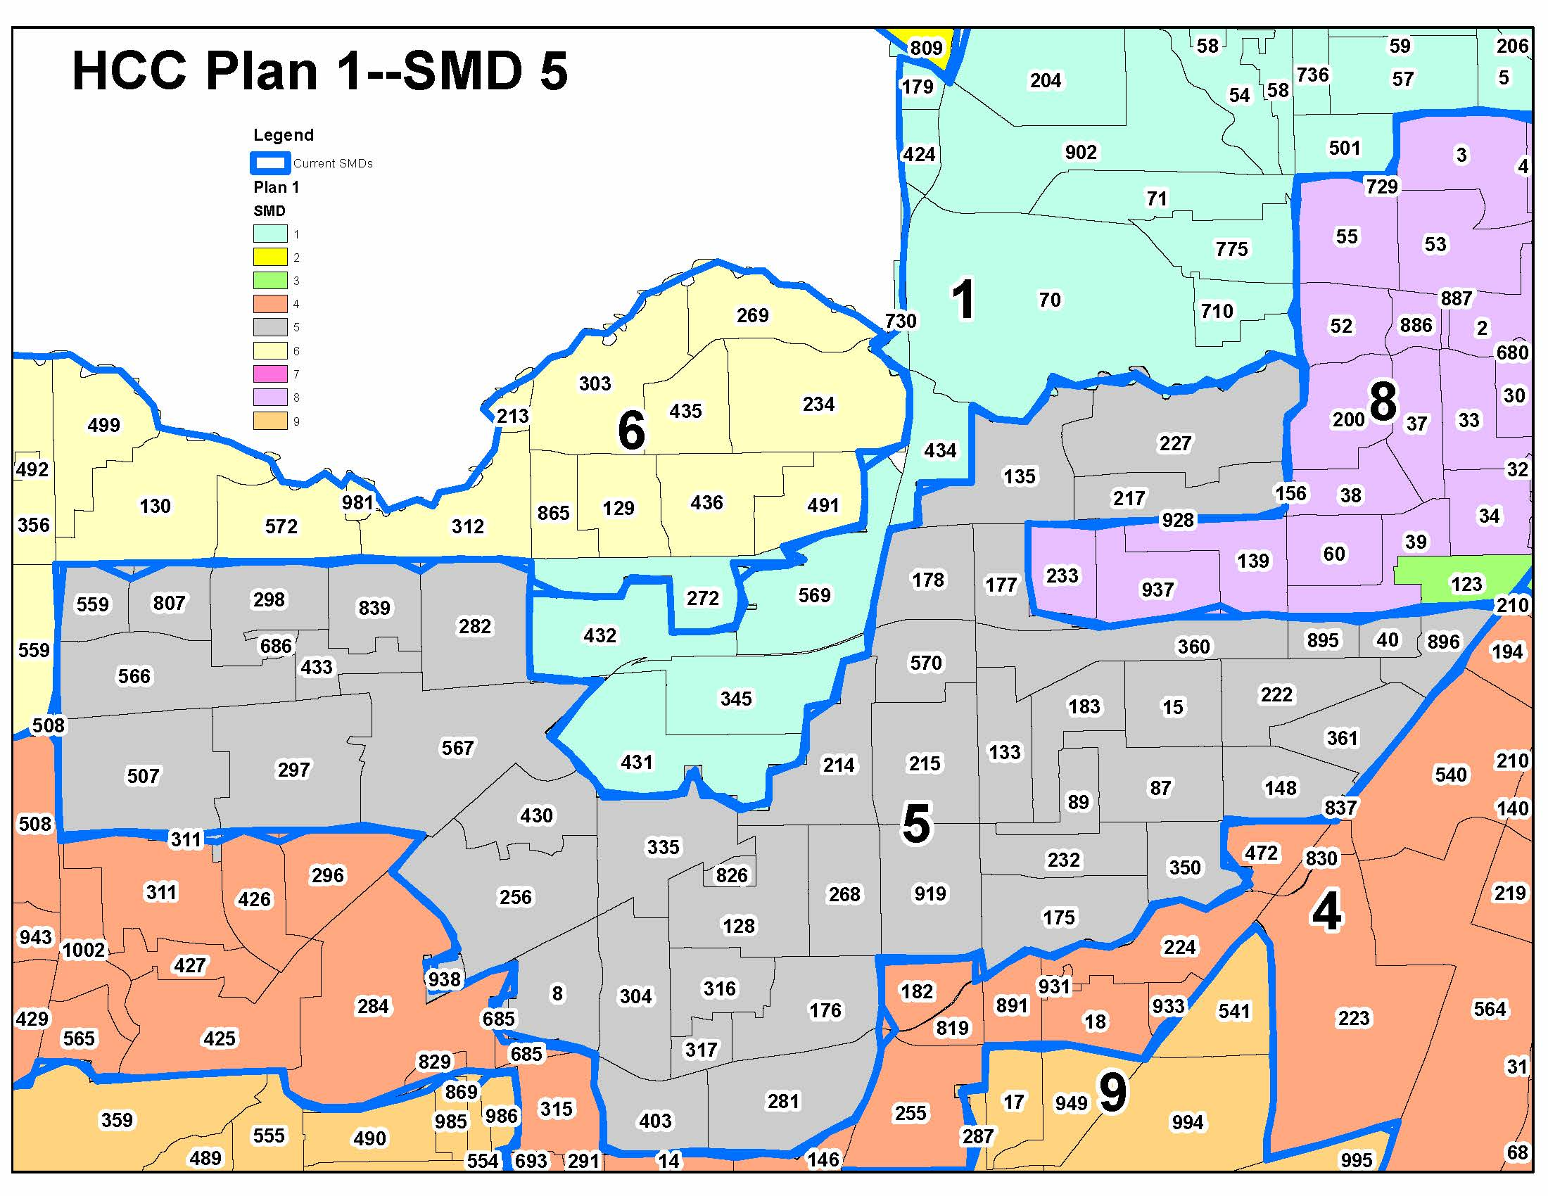
PLAN 1A – SMD 5 CHANGES

Slide 18
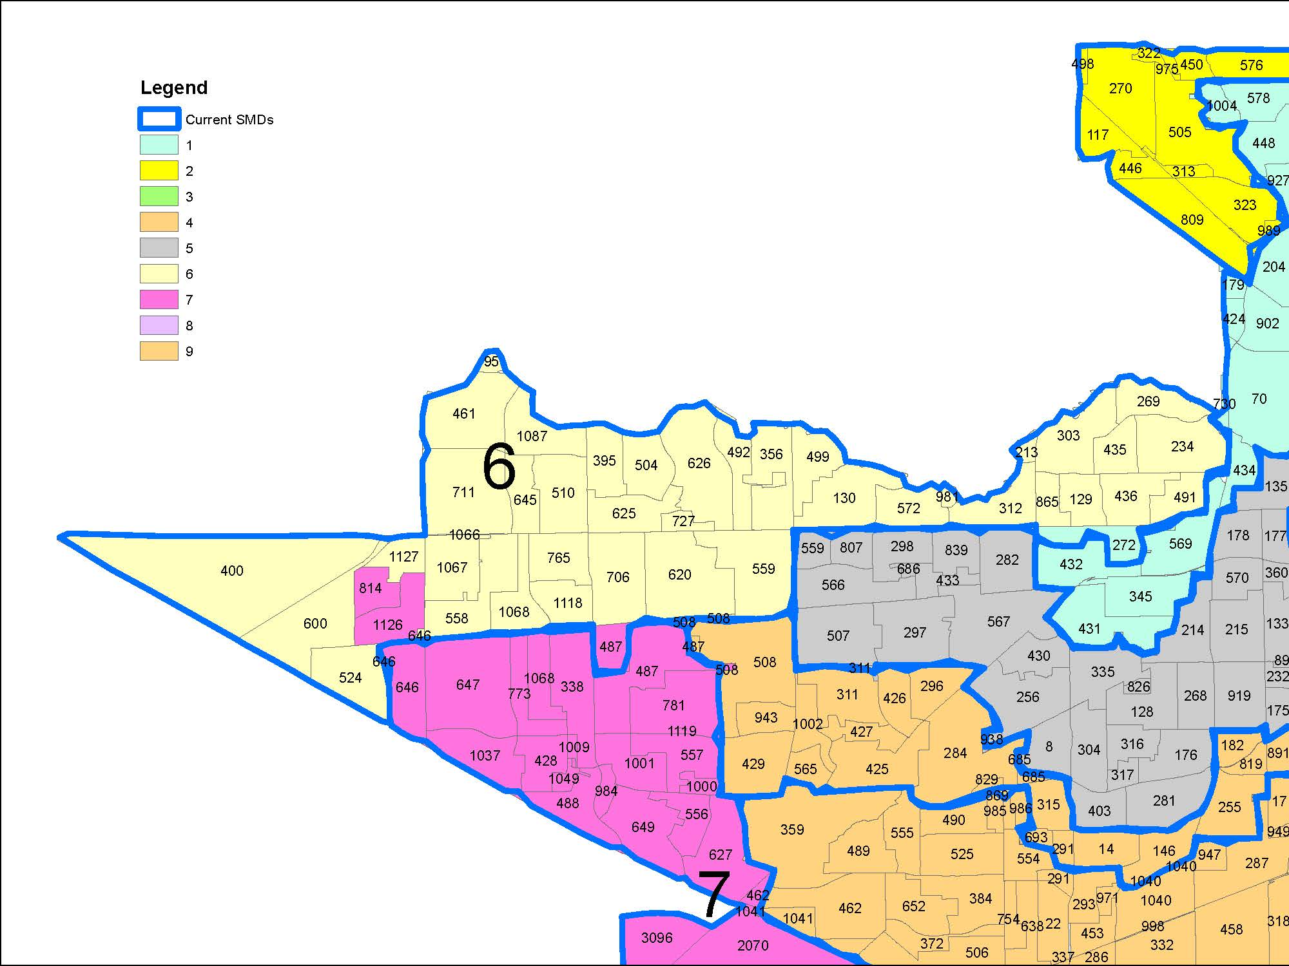
PLAN 1A – SMDs 6 and 7 CHANGES

Slide 19
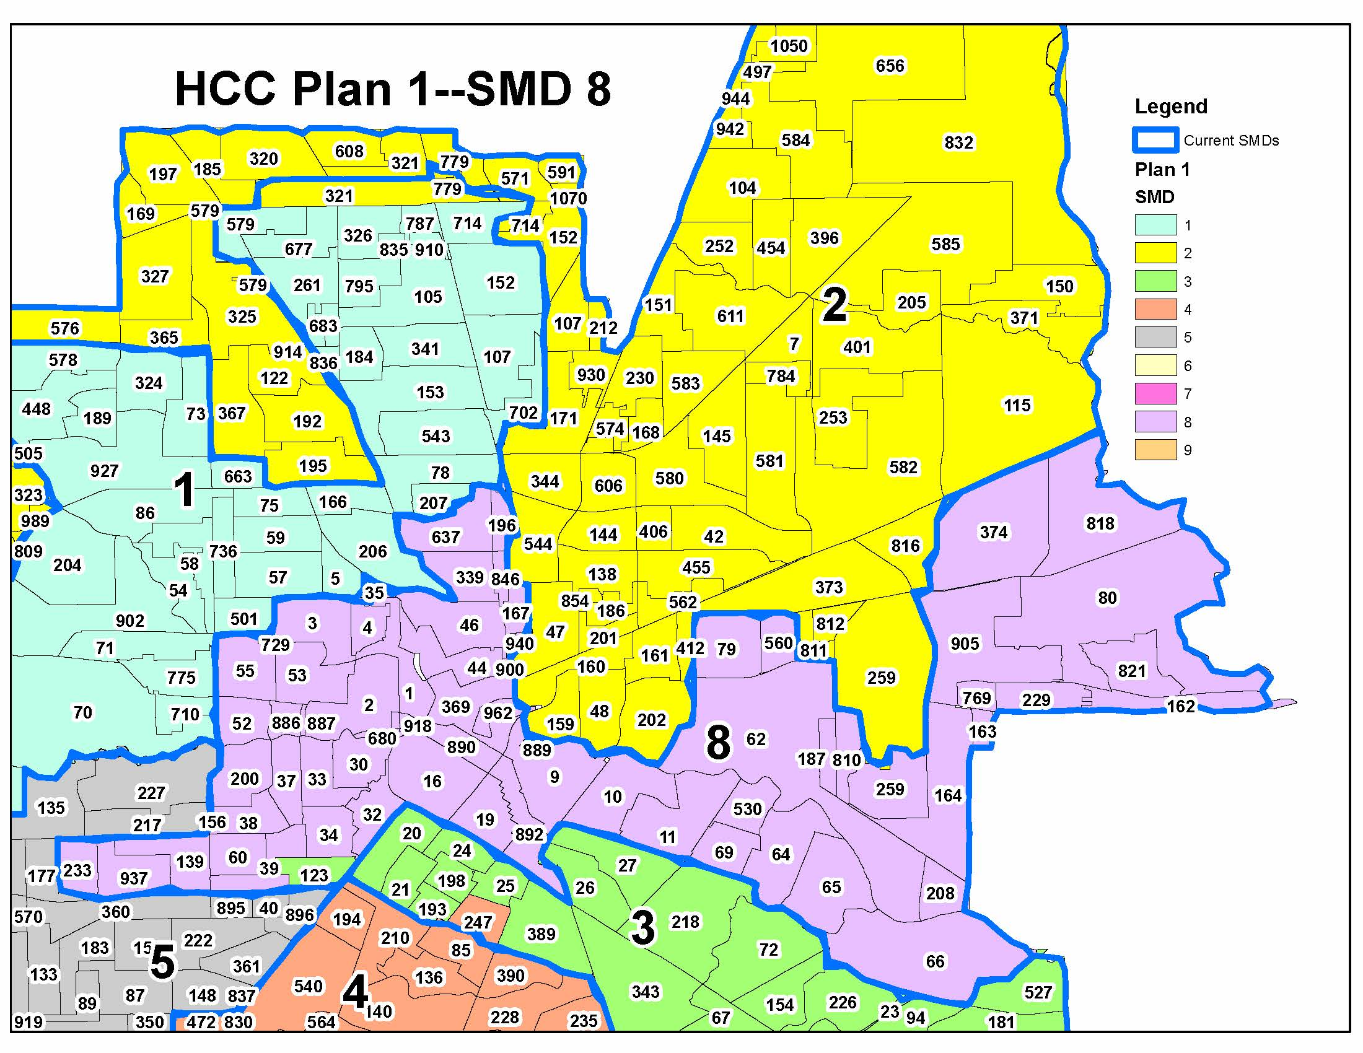
PLAN 1 A – SMD 8 CHANGES

Slide 20
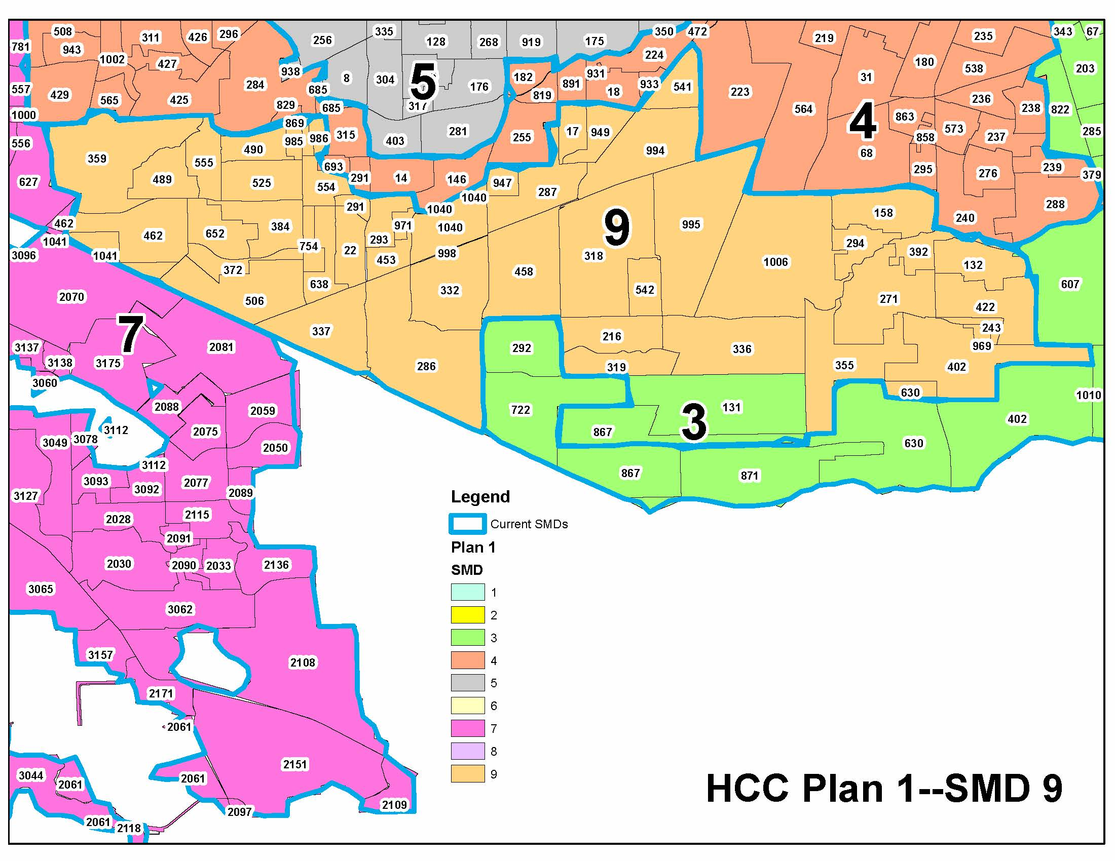
PLAN 1 A – SMD 9 CHANGES

Slide 21
Public Hearing

Slide 22
Next Steps

Slide 23
Next Board Meeting
Date | Meeting | Action
April 19, 2023 | Special Board Meeting on Redistricting | Discuss and consider final maps; Adopt final map.

Slide 24
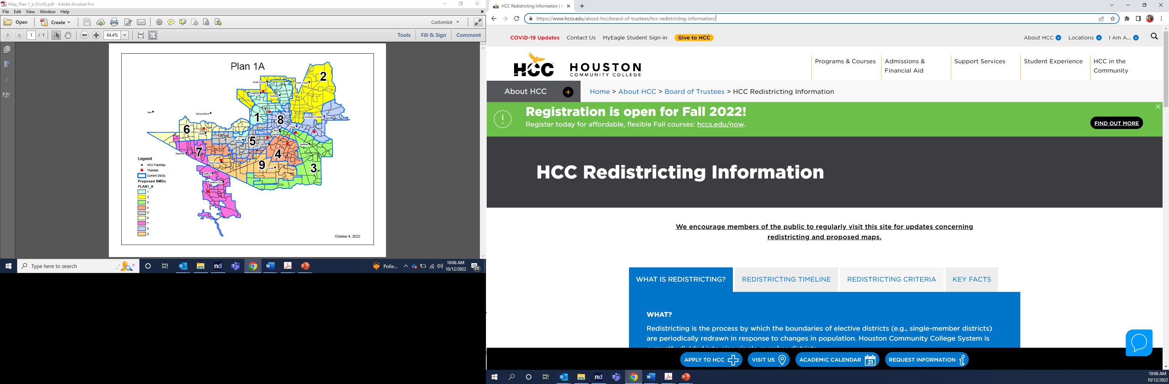
Please visit the HCC Redistricting Website to submit comments and proposed maps:
https://www.hccs.edu/about-hcc/board-of-trustees/hcc-redistricting-information/

Slide 25
Comments and proposed maps must be submitted on the Questions/Feedback page by the deadline:
February 28, 2023

Slide 26
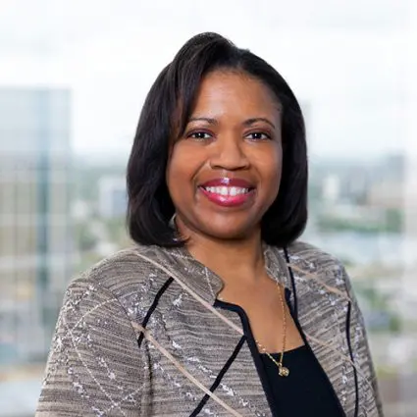
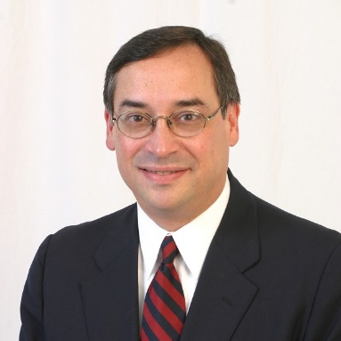

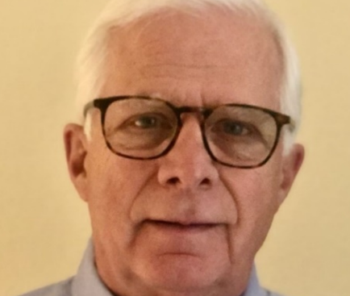
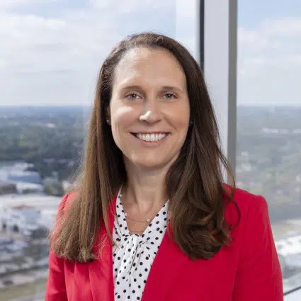
Thank you!
Lisa McBride (713) 554-6747 lmcbride@thompsonhorton.com |  | Edgardo Colón (713) 520-1064 edgar.c@westLLP.com
Celena Vinson (713) 554-6742 cvinson@thompsonhorton.com |  | Dennis Harner (512) 454-1768 ddharner@gmail.com
Paige Martin (713) 554-6756 pmartin@thompsonhorton.com

