Slide 1
SMD 8 Community Forum on Redistricting
Houston Community College System
January 31, 2023

Slide 2

Today’s Objectives
Legal Overview
Population Change Analysis
Proposed Map
Timeline and Next Steps

Slide 3
Legal Overview

Slide 4

Legal Overview
WHAT?
        Redistricting is the process by which the boundaries of elective districts (e.g., single-member districts) are periodically redrawn in response to changes in population. The Houston Community College System is currently divided into nine single-member districts.

Slide 5

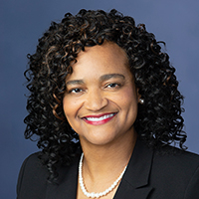

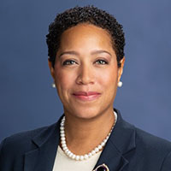
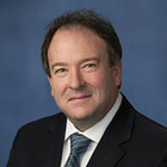
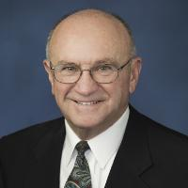

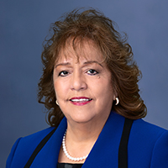

Current Trustees
DISTRICT I
Monica Flores Richart, Vice Chair
DISTRICT II
Charlene Ward Johnson
DISTRICT III
Dr. Adriana Tamez
DISTRICT IV
Dr. Regan Flowers
DISTRICT V
Robert Glaser
DISTRICT VI
Dave B. Wilson
DISTRICT VII
Dr. Cynthia Lenton-Gary, Chair
DISTRICT VIII
Eva L. Loredo, Secretary
DISTRICT IX
Dr. Pretta VanDible Stallworth

Slide 6
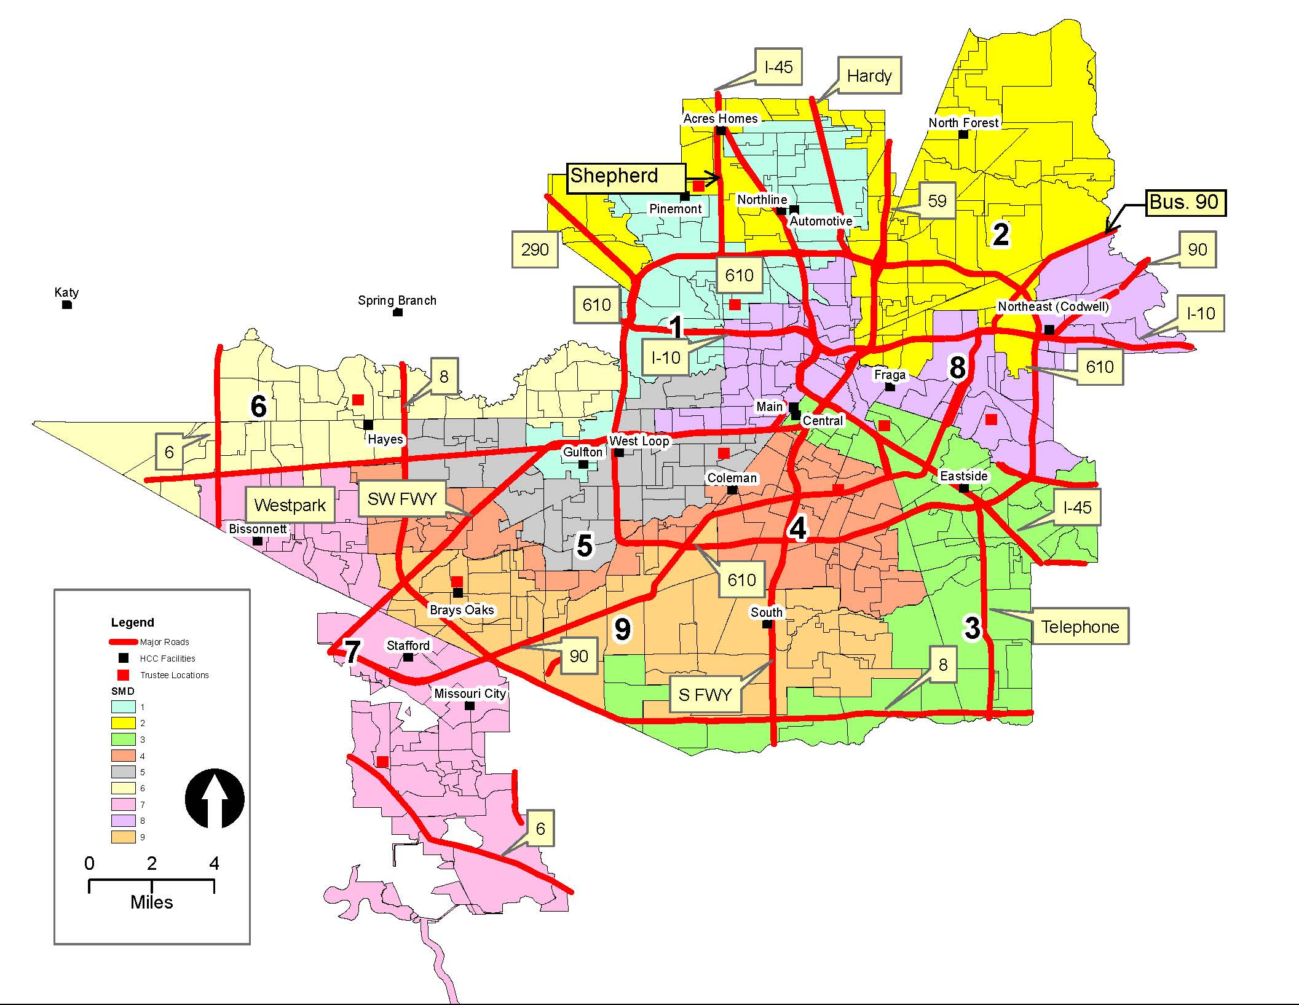
Current Board of Trustees Single Member Districts (2020 Census Blocks)

Slide 7
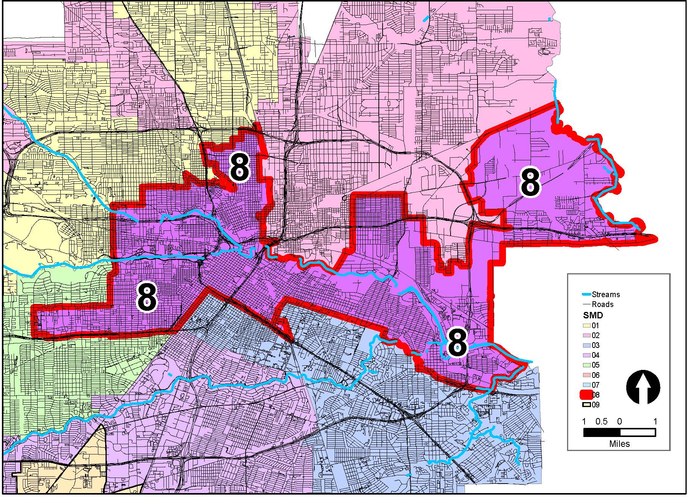
Single Member District 8

Slide 8

Legal Overview
WHY?
        Every ten years, the U.S. Census data is published including the most recent population statistics. Texas Education Code Section 130.0822 (a) and (k) requires a school board to re-divide single-member districts “if the census data indicates that the population of the most populous district exceeds the population of the least populous district by more than 10 percent.”

Slide 9

Legal Overview
WHEN?
        Not later than the 90th day before the day of the first regular trustee election at which trustees may officially recognize and act on the last preceding federal census, the board must redivide the district into the appropriate number of trustee districts if the census data indicates that the population of the most populous district exceeds the population of the least populous district by more than 10 percent.
        Houston Community College System holds elections in November of odd-numbered years. For the November 7, 2023 election date, the Board of Trustees is required to redistrict by August 9, 2023.

Slide 10

What does the Census Report?
The census reports several different population measures:
  Total population
  Voting Age
  Population

Slide 11
Population Measures
Total Population: All persons residing in a jurisdiction on census day—April 1, 2020.
Voting Age Population (VAP): The number of persons on April 1, 2020 who were 18 years of age or older in the jurisdiction.
Citizen Voting Age Population (CVAP): The number of persons who are 18 years of age or older who are citizens in the jurisdiction, calculated using survey data over a period of time.

Slide 12
The Law Governing Redistricting
One Person, One Vote
Shaw v. Reno
Section 2 of the Voting Rights Act
Compliance with Traditional Map Drawing Principles

Slide 13

One Person, One Vote – Equal Voting Strength
SMDs must be drawn with substantially equal population
Avoid overpopulated and under populated districts
Exact equality of population not required (ideal district population)

Slide 14
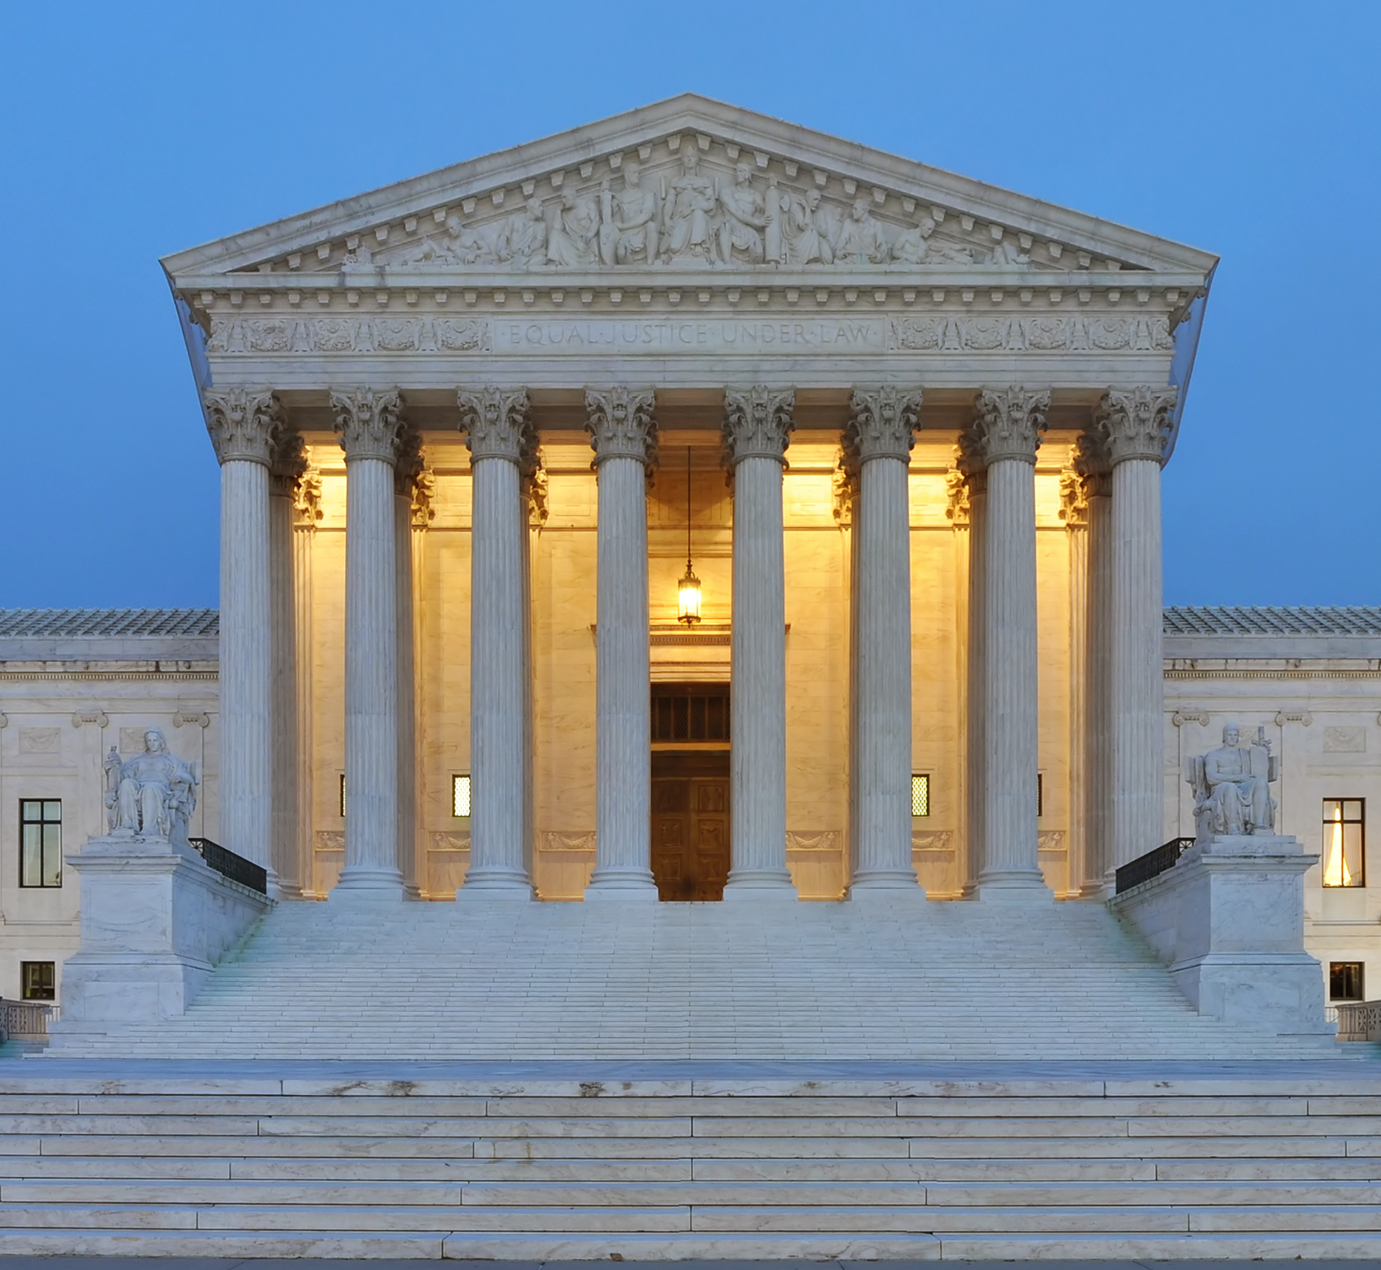
Shaw v. Reno, 509 U.S. 630 (1993)
1993 U.S. Supreme Court case that limits way in which race may be considered

Slide 15

Shaw v. Reno
Under Shaw, generally, race may not be a predominant factor over traditional redistricting principles.
Bizarrely shaped, gerrymandered districts can be evidence of impermissible consideration of race.

Slide 16
Shaw v. Reno
Race can be a predominant consideration when conditions meet standard test for permissible consideration of race under the 14th Amendment (strict scrutiny test)

Slide 17

Shaw v. Reno
Strict scrutiny requires showing that racial factors were to further a compelling state interest (preventing discrimination) and use of these factors was narrowly tailored (only to extent necessary) to accomplish the compelling interest

Slide 18
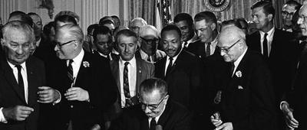
Meeting the requirements of the Federal Voting Rights Act (VRA), 42 U.S.C. § 1973c, can be a compelling state interest
Notes:
Image is Public Domain

Slide 19
VRA has 2 relevant parts – Section 2 and Section 5*
Section 2 of the VRA prohibits a voting qualification, prerequisite, standard, practice or procedure that results in the denial or abridgment of any U.S. citizen's right to vote on account of race, color or status as a member of a language minority group.
*Entities are not currently required to seek pre-approval of electoral changes using Section 5’s preclearance process.

Slide 20
Key Question Under Section 2 of the VRA
Does the voting qualification, prerequisite, standard, practice or procedure reduce the opportunity of members of a protected minority group to participate in the political process and to elect representatives of their choice?

Slide 21
Types of VRA Challenges: “Cracking” and “Packing”
Cracking:
Section 2 challenge by a concentrated minority group that is divided between two or more SMDs who contend that the arrangement deprives the group of the ability to elect the candidate of their choice that they would have if left united in a single SMD.
Packing:
Section 2 challenge by a minority group that has been placed into one or more SMDs in concentrations in excess of what is needed to elect the candidate of their choice preventing the group from winning elections in other SMDs in which the excess minority voters could have been located.

Slide 22
Traditional Redistricting Criteria
Total deviation between largest and smallest district at or within 10%
Near-equal population
Avoid dilution/retrogression of minority voting rights
Compact and contiguous
Easily identifiable boundaries when possible
Preserve incumbent-constituency relations
Maintain communities of interest and keep neighborhoods together
Preserve existing SMD boundaries when possible
Avoid splitting county election precincts to the extent possible*

Slide 23
Population Change Analysis

Slide 24
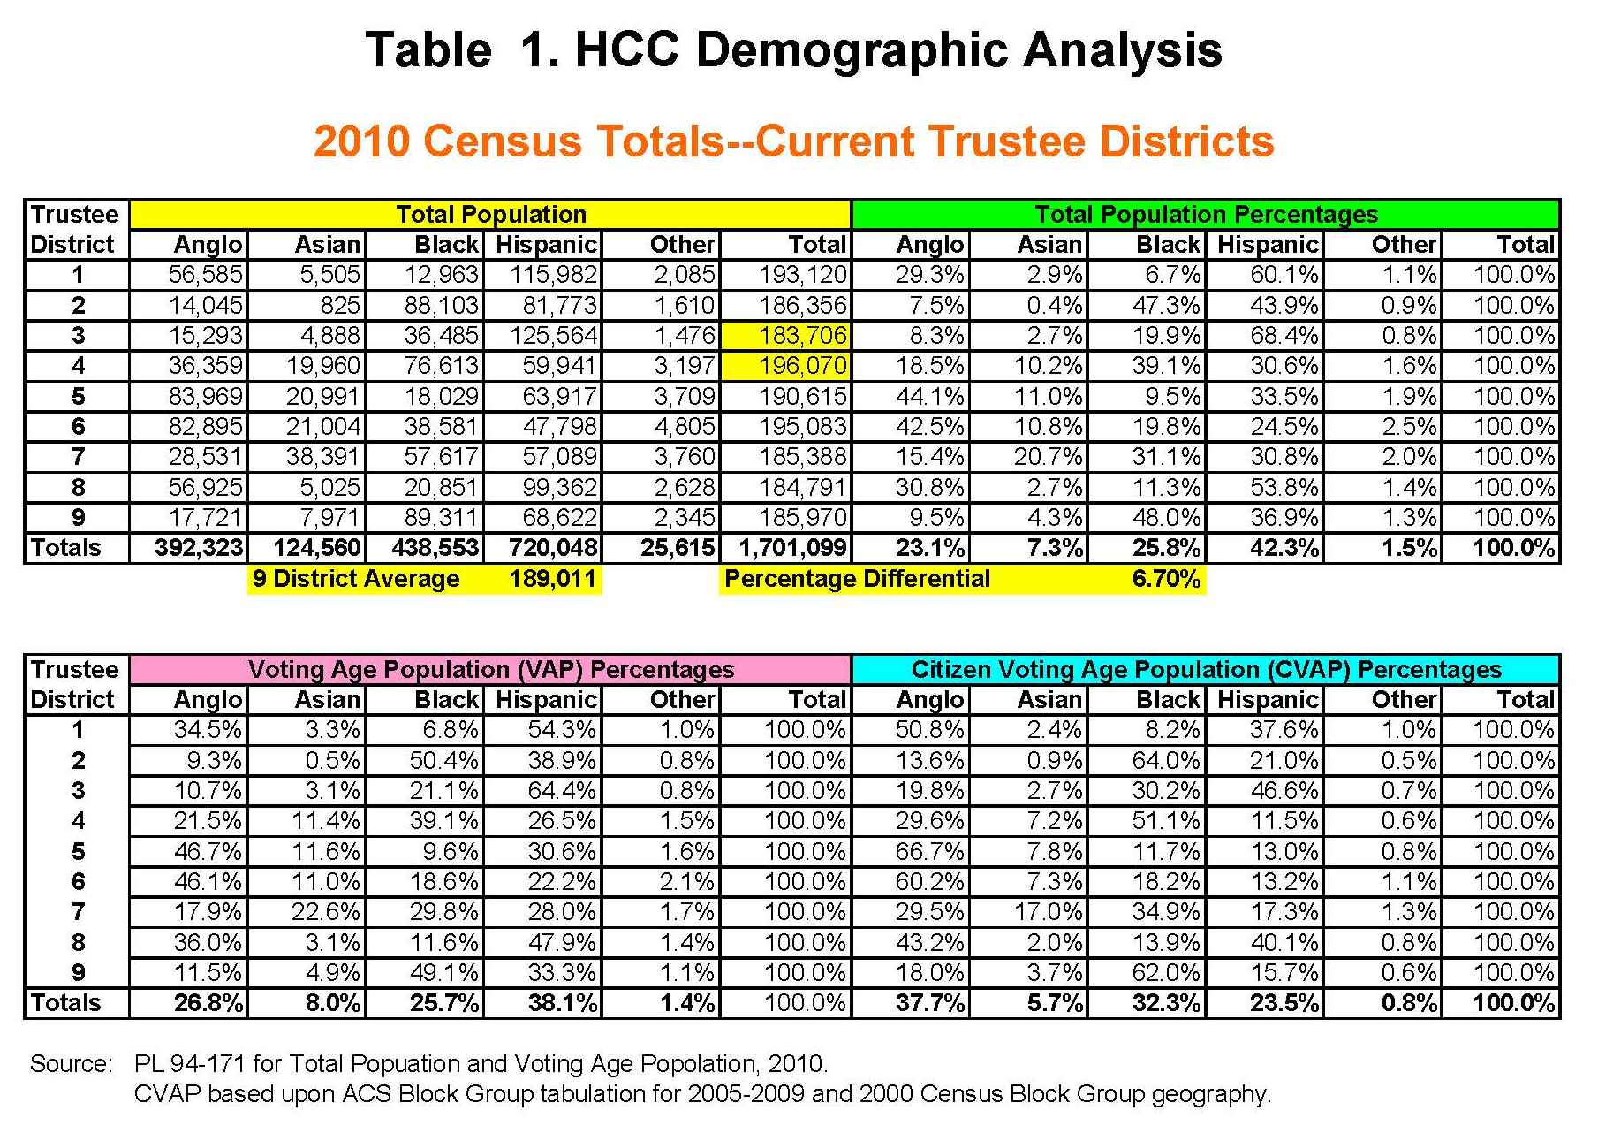

Slide 25
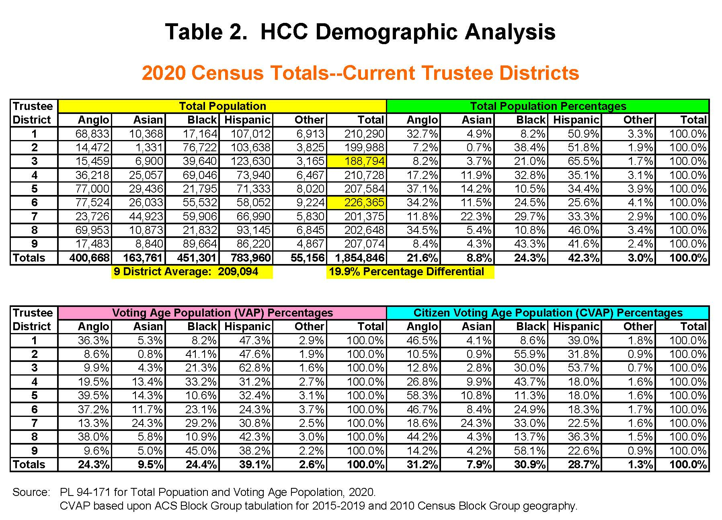

Slide 26
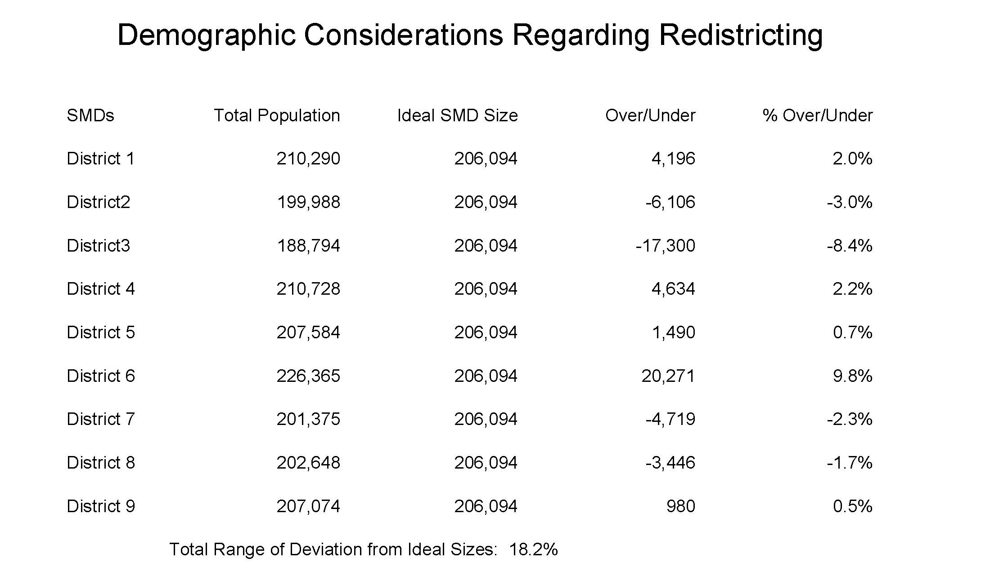

District 2
District 3

Slide 27
Key Takeaways
Houston Community College added 153,747 persons from 2010 to 2020
Total District Population is now 1,854,846 persons
Total population differential between most and least populous SMDs exceeds 10% (19.9%)
Most populous SMD changed from SMD 4 in 2010 to SMD 6 in 2020
Least populous district in 2010 & 2020 is SMD 3
Redistricting is required

Slide 28
Plan 1A and Demographics

Slide 29
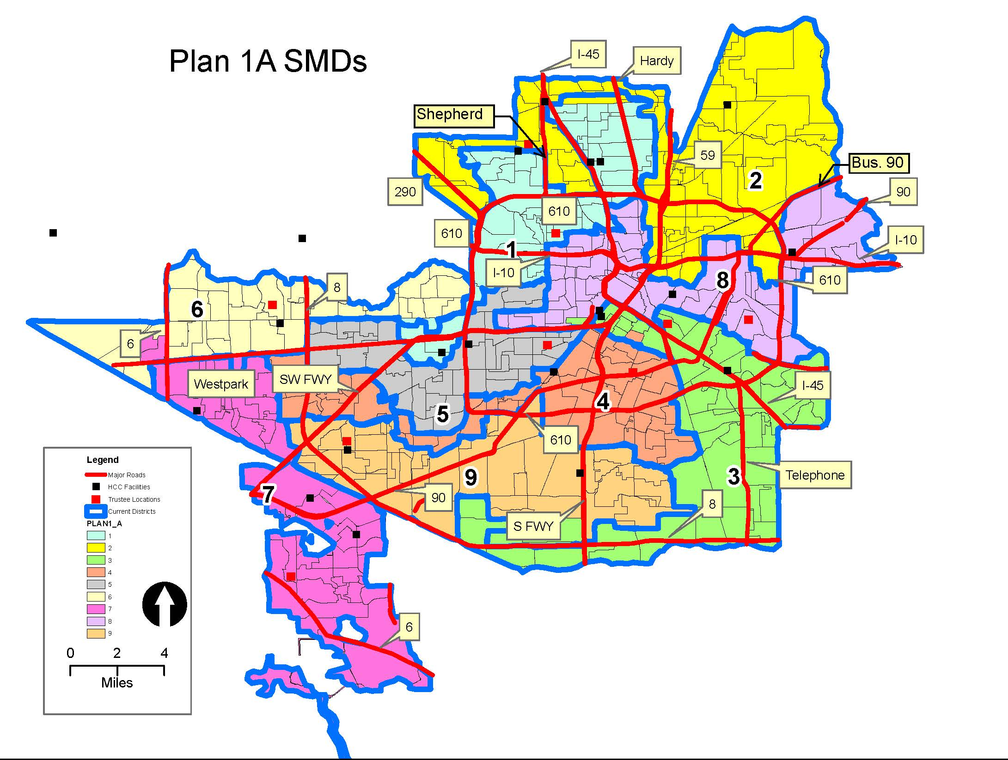

Slide 30
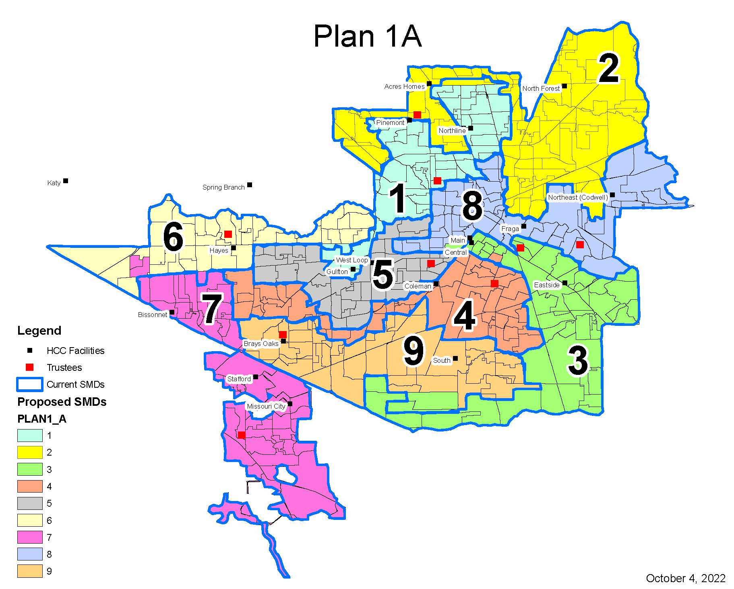






Slide 31
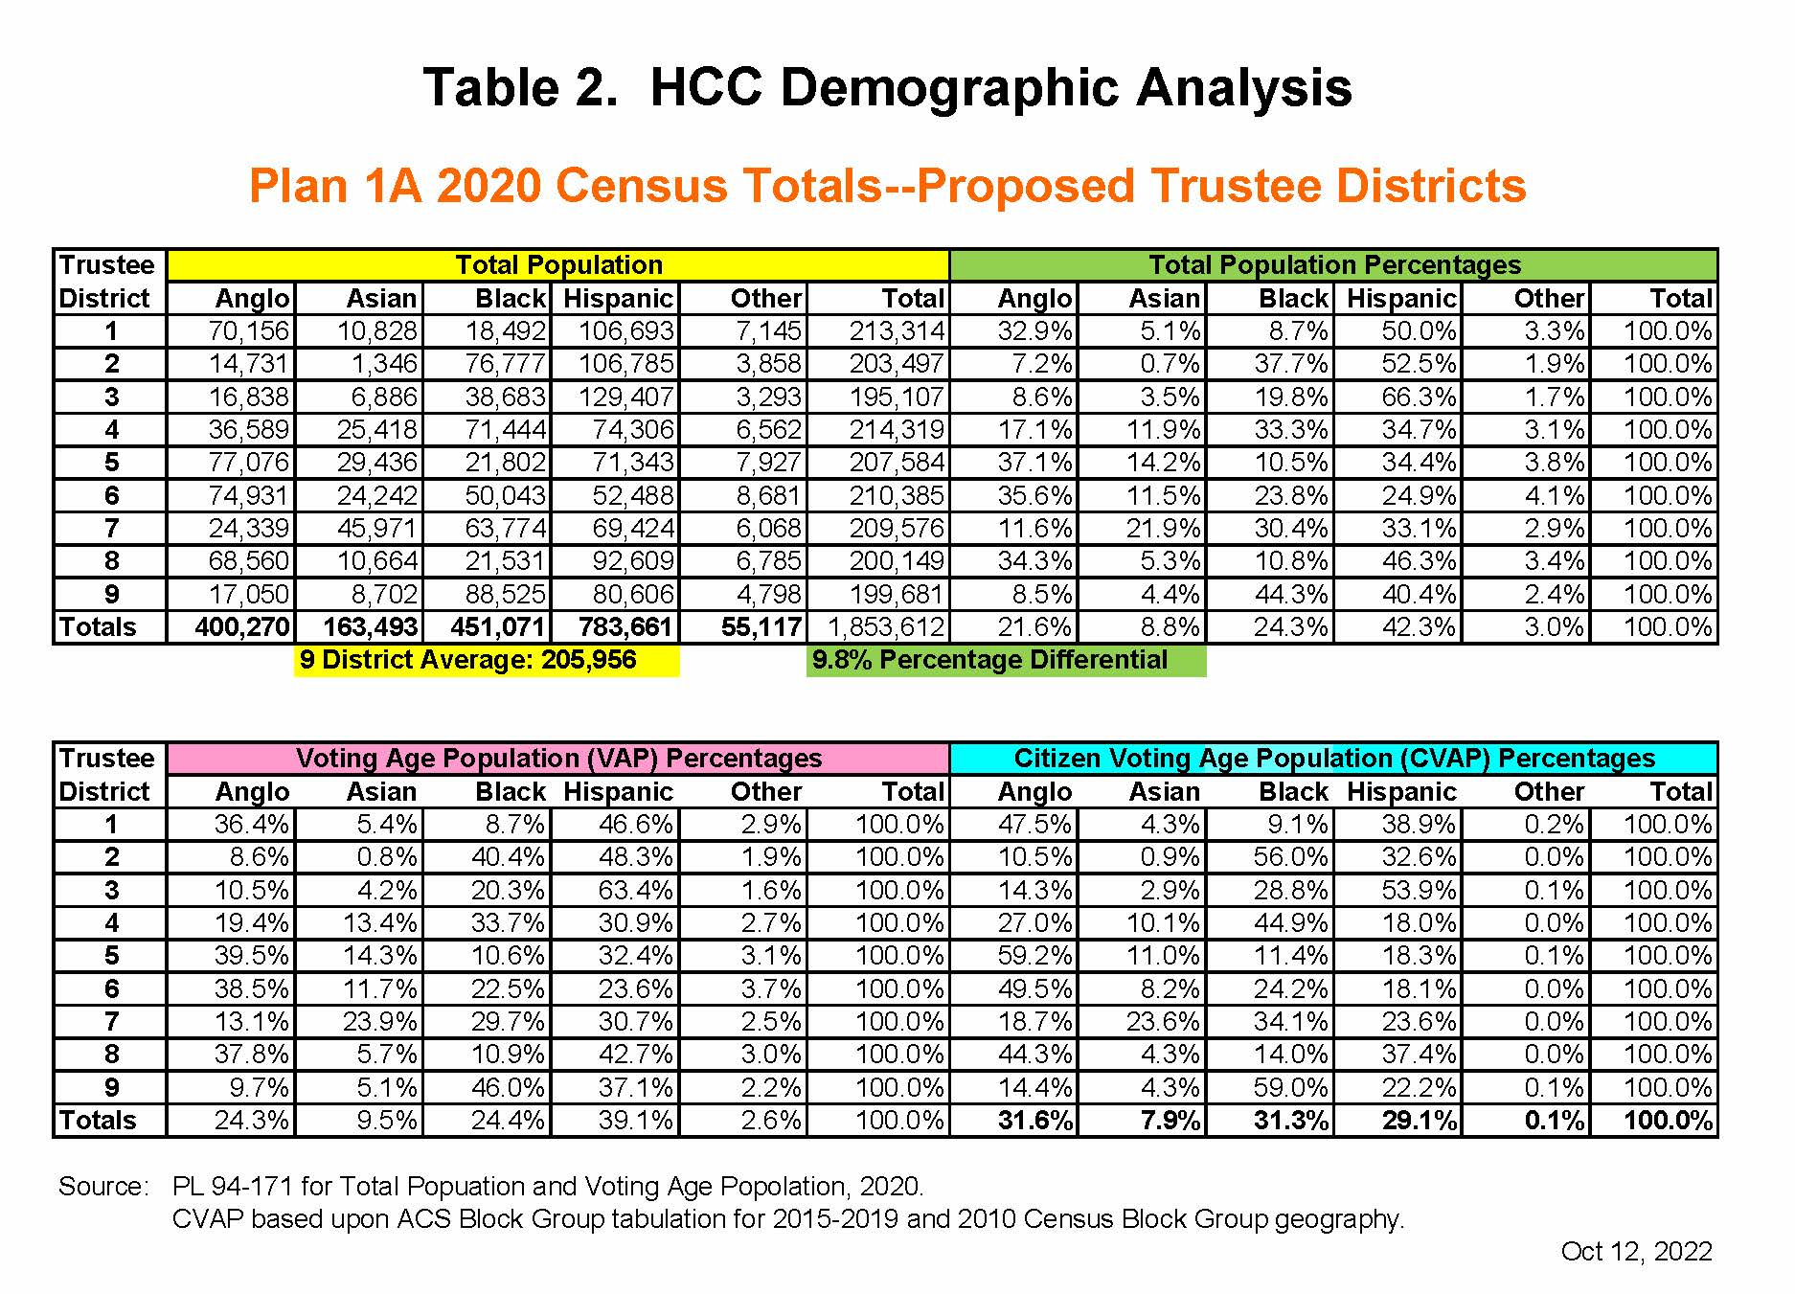

Slide 32
Plan 1A - Summary of Changes
SMD 1 gains population from SMD 6 in the SW
    Precinct 272
SMD 1 loses population to SMD 2 in the North
    Precincts 321, 571, 779
SMD 2 gains population from SMD 1 in Central South
    Precincts 321, 571, 779
SMD 3 loses population to SMD 4 in the NW
    Precinct 247
SMD 3 gains population from SMD 9 in the SW
    Precincts 131, 867
SMD 3 gains population from SMD 8 in the NW
    Precinct 123
SMD 4 gains population from SMD 3 in the North
    Precinct 247
SMD 5 gains population from SMD 8 in the NW
    Precincts 177, 895
SMD 6 loses population to SMD 7 in the West and Central South
    Precincts 814, 1126, 487
SMD 6 loses population to SMD 1 in the East
    Precinct 272
SMD 7 gains population from SMD 6 in the North
    Precincts 814, 1126, 487
SMD 8 loses population to SMD 5 in the W and S
    Precincts 177, 895
SMD 8 loses population to SMD 3 in SW
    Precinct 123
SMD 9 loses population to SMD 3 in the SE
    Precincts 131, 867

Slide 33
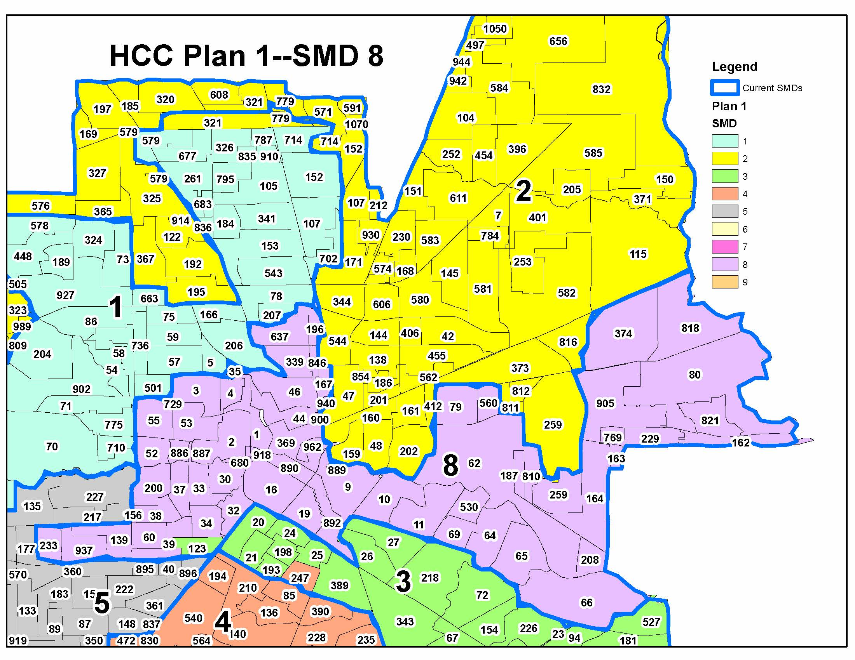
PLAN 1 A – SMD 8 CHANGES

Slide 34
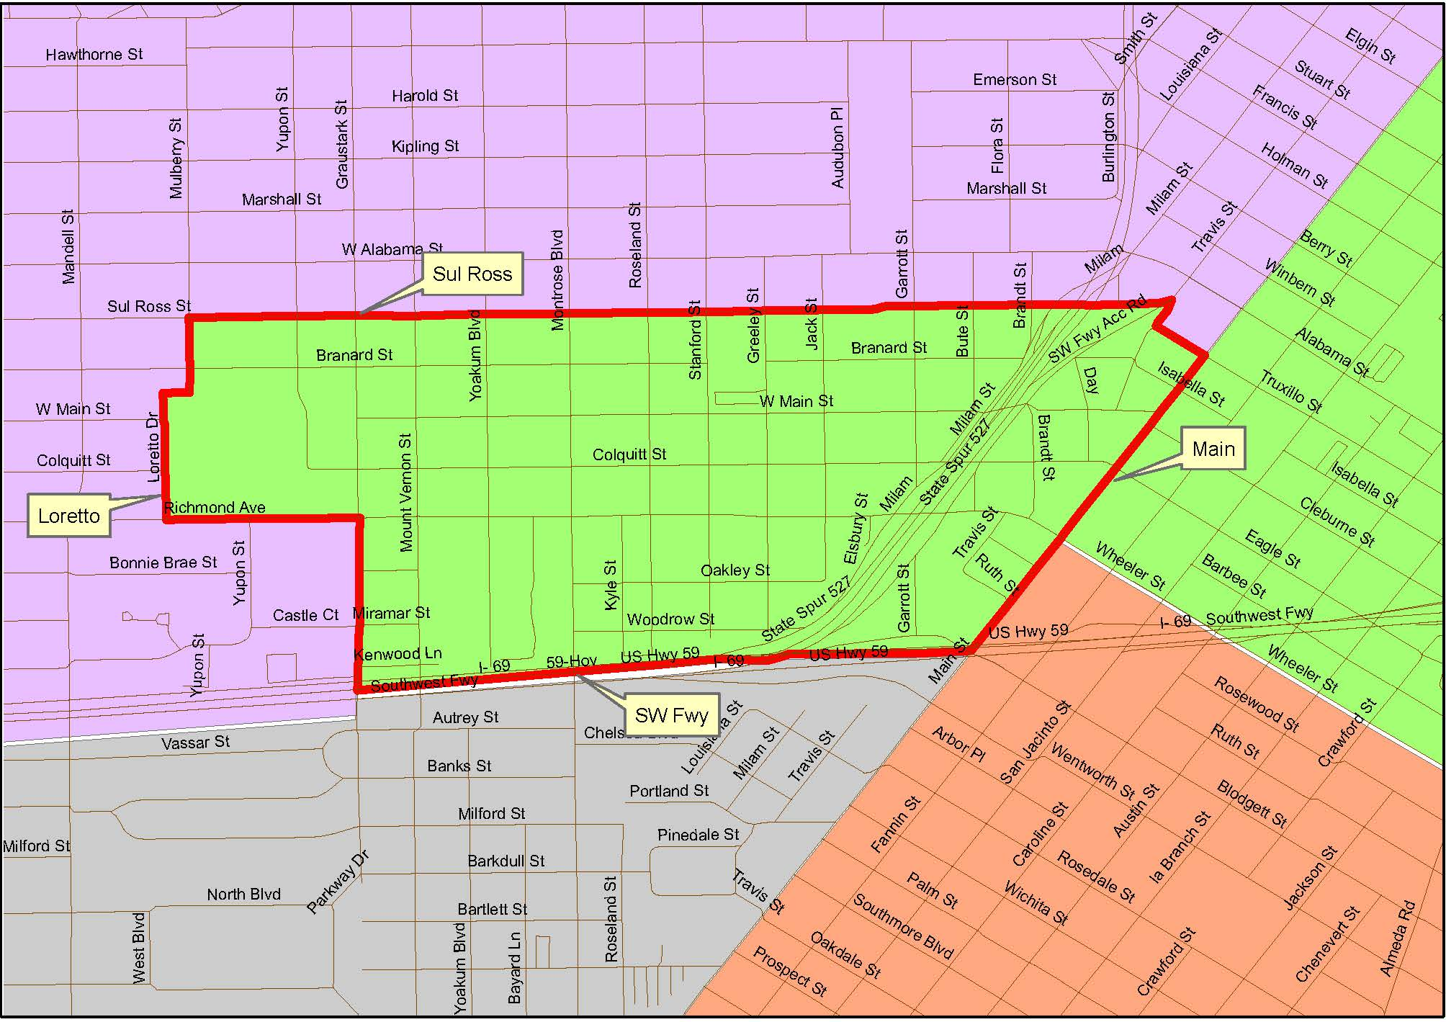
Move from SMD 8 to
SMD 3

Slide 35
Questions and Answers

Slide 36
Timeline and Next Steps

Slide 37
Board Adopted Timeline
Date | Meeting | Action
January – February 2023 | Redistricting Community Forums in each Single Member District | Legal team and demographer present maps to the public and accept comments on maps
February 15, 2023 | Regular or Special Board Meeting on Redistricting | Formal public hearing on maps; Board receives summary of website and single member district community forum public comments on maps; Board receives vote dilution/retrogression analysis
April 19, 2023 | Special Board Meeting on Redistricting | Discuss and consider final maps; Adopt final map (6 months prior to November 2023 election)

Slide 38
Redistricting Community Forums All Forums begin at 6:30 pm
District | Date | Location
V | Mon, January 9, 2023 | Southwest College – West Loop Campus
II | Tues, January 10, 2023 | Northeast College - North Forest Campus
III | Thurs, January 12, 2023 | Central College – Dr. William W. Harmon Building
IV | Tues, January 17, 2023 | Emancipation Cultural Center
I | Thurs, January 19, 2023 | Northeast College – Northline Campus
VI | Mon, January 23, 2023 | Northwest College – West Houston Institute
VII | Mon, January 30, 2023 | Southwest College – Missouri City Campus
VIII | Tues, January 31, 2023 | Southeast College – Fraga Campus
IX | Thurs, February 2, 2023 | Central College – South Campus

Slide 39
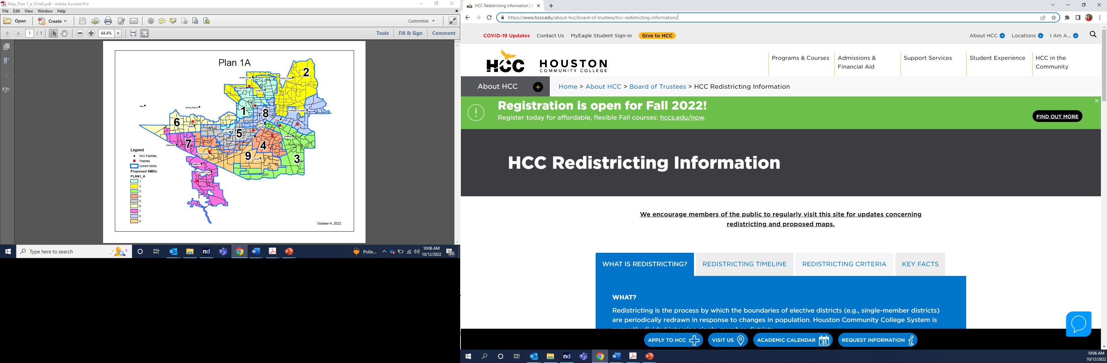
Please visit the HCC Redistricting Website to submit comments and proposed maps:
https://www.hccs.edu/about-hcc/board-of-trustees/hcc-redistricting-information/

Slide 40
Comments and proposed maps must be submitted on the Questions/Feedback page by the deadline:
February 28, 2023

Slide 41

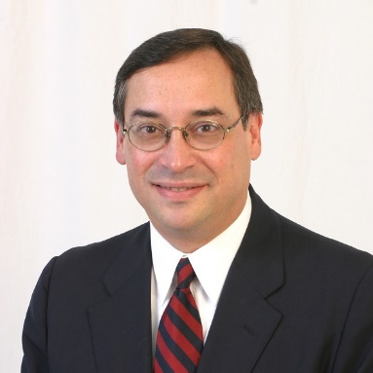



Thank you!
Lisa McBride (713) 554-6747 lmcbride@thompsonhorton.com |  | Edgardo Colón (713) 520-1064 edgar.c@westLLP.com
Celena Vinson (713) 554-6742 cvinson@thompsonhorton.com |  | Dennis Harner (512) 454-1768 ddharner@gmail.com
Paige Martin (713) 554-6756 pmartin@thompsonhorton.com

